Slide 1
Insight & Lessons from the RNG Industry Perspective
September 2017
CONFIDENTIAL AND PROPRIETARY

Slide 2
“Emissions House of the Year”
`
Launched in 2005, Element Markets has become a leading producer and marketer of Renewable Natural Gas (“RNG”) and environmental commodities in the US.
Transacted over $1.6 billion in environmental commodities since inception
Currently provides environmental asset management services for over 6,000 MW and 18 landfill gas projects
Extensive expertise in the major North American RNG Market
Customer base of over 800 companies within the environmental markets
Robust back-office and risk management practices for ease of execution
Founding Member of the RNG Coalition
Marketing
Emissions & GHG Credits
Renewable Energy Credits
RNG & RINs
Largest regional marketer of emission credits in US
Offset project developer managing 18 GHG projects
Transacted over 40 million tonnes of GHG credits
Active in all compliance and voluntary REC markets in North America
Transacted over 19 million RECs
Have transacted RECs in 38 different markets
Currently Marketing RNG from 6 different Projects + More Pending
Successfully Generating RINs and LCFS from RNG
Over 50 million RINs transacted

Slide 3
RNG Marketing
Element Markets has been a leading marketer of RNG since 2009.
The company has transacted over 9MM dekatherms of RNG since inception, with large sales to the generation, transportation, and voluntary markets.
Registered as a RIN generator with several RNG production facilities.
9 RNG facilities registered under RFS with 3 additional pending.
Master Sales Agreements in place with all of the major Obligated Parties.
Three Business Lines
RNG to Electricity
RNG to Transportation
RNG for Voluntary (CDP, Green-e)
Supplies RNG to RPS markets
Strong relationships with Municipal and Utility Buyers.
Supplies RNG to CNG and LNG to producer
Markets RINs and LCFS credit generated from CNG and LNG production
Provides Asset Management Services for EPA and CARB compliance
Pioneered the supply of RNG to voluntary buyers.
Markets Green-e approved RNG derived Environmental Attributes as a low cost solution
Markets long term, fixed priced RNG to voluntary buyers
Transaction History
EM was of the largest suppliers of RPS qualifying RNG to the California Market
Over 60 million RINs transacted to date
First to register landfill RNG facility with a specific Carbon Intensity under LCFS
Largest Supplier of D3 RINs to 2 of the 3 largest refiners in US
Supplied over 3MM dekatherms of RNG credits to voluntary buyers.
Contracted 15 year off-take with Fortune 10 buyer for RNG needs associated with fuel cells

Slide 4
Key Points of the US Renewable Fuel Standard
The RFS program is a federal policy that requires a certain volume of renewable fuel to replace or reduce the quantity of petroleum-based transportation fuel, heating oil or jet fuel
Mandatory participants are called “obligated parties” and consists of US refiners and importers of gasoline and diesel
There are 4 renewable fuel types – each assigned a category code under the RFS2
Cellulosic biofuel - classified a D3 (e.g., cellulosic biofuel) or D7 (cellulosic diesel)
Biomass-based diesel - classified a D4
Advanced biofuel - classified a D5
Renewable fuel (non-advanced/conventional biofuel) - classified a D6
Renewable Identification Numbers (RINs) are the credits that obligated parties use to demonstrate compliance
Obligated parties must obtain sufficient RINs for each category in order to demonstrate compliance with the annual obligation
The EPA resets the Renewable Volume Obligation (RVO) annually thereby establishing the number of RINs each Obligated Party must retire for the following calendar year
There is no “sunset” date to RFS

Slide 5
Introduction to RFS and LCFS RFS and LCFS Both Incentivize Renewable Fuels in Transportation
Renewable Fuel Standard (RFS)
Goal: to reach 36,000,000,000 gallons of renewable fuel in the fuel pool by 2022
Enforced by EPA Renewable Identification Numbers (RINs) represent 1 ethanol-gallon-equivalent of renewable fuel
RNG earns 11.727 RINs/dth
Low-Carbon Fuel Standard (LCFS)
Goal: to reduce the carbon intensity of California fuels by 10% by 2020
Enforced by California Air Resources Board (state)
LCFS credits represent 1 metric ton of CO₂ emissions reductions
Carbon intensity is grams of CO₂ emitted per MJ
Landfill generated RNG earns ~ 0.03 Incremental LCFS credits/dth, depending on carbon intensity*
* 0.03 LCFS credits are incremental to LCFS credits generated from natural gas LNG and CNG when reporting under EM’s pathway.
Renewable transportation fuels used in California generate both RINs and LCFS Credits so long as the fuel is transported and consumed in CA

Slide 6
RFS Volume Standards Target Volume of 36 Billion by 2022
Volume Standards as Set Forth in EISA [billion gallons]
EPA sets actual standards each November; standards below are as published in the Act
Conventional Renewable Fuels + Total Advanced = Total Renewable Fuels
Cellulosic
Advanced
Advanced Biomass
Based Diesel
Non-Cellulosic
Advanced
=
+
+
Total Advanced
Year | Conventional Renewable Fuels (D6) | Advanced Biofuels (D3, D4, D5) |  |  |  | Total Renewable Fuels (D3, D4, D5, D6)
 |  | Cellulosic Biofuel (D3) | Biomass-Based Diesel (D4) | Non-Cellulosic Advanced (D5) | Total Advanced Biofuels
2008 | 9.0 |  |  |  |  | 9.0
2009 | 10.5 |  | 0.5 | 0.1 | 0.6 | 11.1
2010 | 12.0 | 0.1 | 0.65 | 0.2 | 0.95 | 12.95
2011 | 12.6 | 0.25 | 0.80 | 0.3 | 1.35 | 13.95
2012 | 13.2 | 0.5 | 1.0 | 0.5 | 2.0 | 15.2
2013 | 13.8 | 1.0 | 1.0 | 0.75 | 2.75 | 16.55
2014 | 14.5 | 1.75 | 1.0 | 1.00 | 3.75 | 18.15
2015 | 15.0 | 3.0 | 1.0 | 1.50 | 5.5 | 20.5
2016 | 15.0 | 4.25 | 1.0 | 2.00 | 7.25 | 22.25
2017 | 15.0 | 5.5 | 1.0 | 2.50 | 9.0 | 24.0
2018 | 15.0 | 7.0 | 1.0 | 3.00 | 11.0 | 26.0
2019 | 15.0 | 8.5 | 1.0 | 3.50 | 13.0 | 28.0
2020 | 15.0 | 10.5 | 1.0 | 3.50 | 15.0 | 30.0
2021 | 15.0 | 13.5 | 1.0 | 3.50 | 18.0 | 33.0
2022 | 15.0 | 16.0 | 1.0 | 4.00 | 21.0 | 36.0
EPA set 2017 RVO at
311 MM; a 35% increase over 2016.
Market is currently pacing short with 115MM reported as of July 31

Slide 7
RFS - Renewable Pathways
Biomethane is the feedstock, CNG and LNG produced with Biomethane will produce either a Cellulosic Biofuel or an Advanced Biofuel
In either case, biomethane must be injected into a common carrier pipeline for delivery to CNG/LNG facilities or used at an on-site CNG/LNG facility
Production facilities must be registered with the EPA prior to producing qualified fuels
CNG/LNG Cellulosic Biofuel (D3) can be produced from the following feedstock sources:
Landfill biomethane
Separated municipal solid waste digester biomethane
Municipal wastewater treatment facility digester biomethane
Agricultural digesters biomethane (manure, crop residues, separated yard waste)
Advanced Biofuel (D5) can be produced from biomethane derived from protein production byproducts and/or separated food waste anaerobic digesters

Slide 8
Biomethane CNG/LNG Pathway
Environmental Attribute separation, tracking and matching
Accounting of biomethane usage and inventory
Eligibility of
Supplier is
established
EA’s married with natural gas deliveries
Biomethane is injected into Common Carrier Pipeline
Natural gas deliveries made by 3rd party
Btu
Btu
Natural Gas Sale
Natural
Gas Usage
Btu
Btu
Biogas
Plant
Biomethane Injection
Gas
Delivery
CNG/LNG Facility
DOCUMENTATION
Sales Contracts;
Monthly invoices by Biogas Plant;
Documentation establishing plant eligibility approved by EPA
Pipeline statements with utility-grade meter data of biogas injection;
Producer attestation establishing quantity and transfer of Environmental Attributes
Invoices and/or pipeline statements of Natural Gas sales and purchase;
Stringent accounting of Environmental Attributes
Pipeline statements with utility-grade meter data of natural gas delivery;
Data on the facility’s gas consumption, inventory and sales;
Documentation needed for verification
Documentation for banking/inventory of RNG

Slide 9
Lookback at Biomethane Gross Yields
There are market costs associated with credit generation that are not accounted for in this slide

Slide 10
Contracting for Biomethane Offtake
Producer needs to identify and determine the level of financial and contractual risk they are willing to take:
Financial Considerations
Debt Coverage; Operating Cashflow needs
Ability to handle volatility of commodities markets
Contractual Risks
Minimum delivery requirements
Project Registration with EPA – Registrant becomes the RIN Generator and takes on associated risks of generation, record keeping and EPA required audits
Marketing Consideration
Supply chain management
Gas scheduling, management and delivery
CNG/LNG Conversion
Monetization of Credits
Offtake contracts with Obligated Parties

Slide 11
Contract Structures
Fixed Price Structure
Fixed price paid for every MMBtu of Biomethane Delivered
Usually at steep discount to spot market
Will have minimum delivery requirements with liquated damages
Possible Change in Law termination clause
Facility has no participation in EA revenue but must agree to provide documentation and allow for site visits
Necessary for financing
Variable Structure
Revenue Share
Seller transfers biomethane to marketer in return for the majority of the net margin
Seller can retain EPA registration or allow marketer to be the Registrant
Higher upside but market risk
Not useful for financing
Hybrid Structure
Floor Price for biomethane plus share of EA revenue
Provides certainty of break even cashflow
Allows for some upside with no downside

Slide 12
How Biomethane Moves in the Market
Biomethane and associated Environmental Attributes are received by marketer at pipeline injection point
Marketer delivers biomethane to their portfolio of contracted renewable fuel tolling facilities, where biomethane is used to produce Cellulosic biofuel (CNG/LNG)
Tolling facilities may include California capacity, where LCFS credits can be generated in addition to RINs
Biomethane is delivered via exchange - biomethane injection can be directly matched to delivery, without the need for owning pipeline capacity
Once Cellulosic Biofuel is dispensed, renewable fuel credits (e.g. RINs & LCFS credits) are generated, usually by marketer
LNG – Bill of Lading and Buyer Attestation
CNG – Meter Data and Buyer Attestation
Marketer then transacts either directly with obligated parties or through the secondary broker market

Slide 13
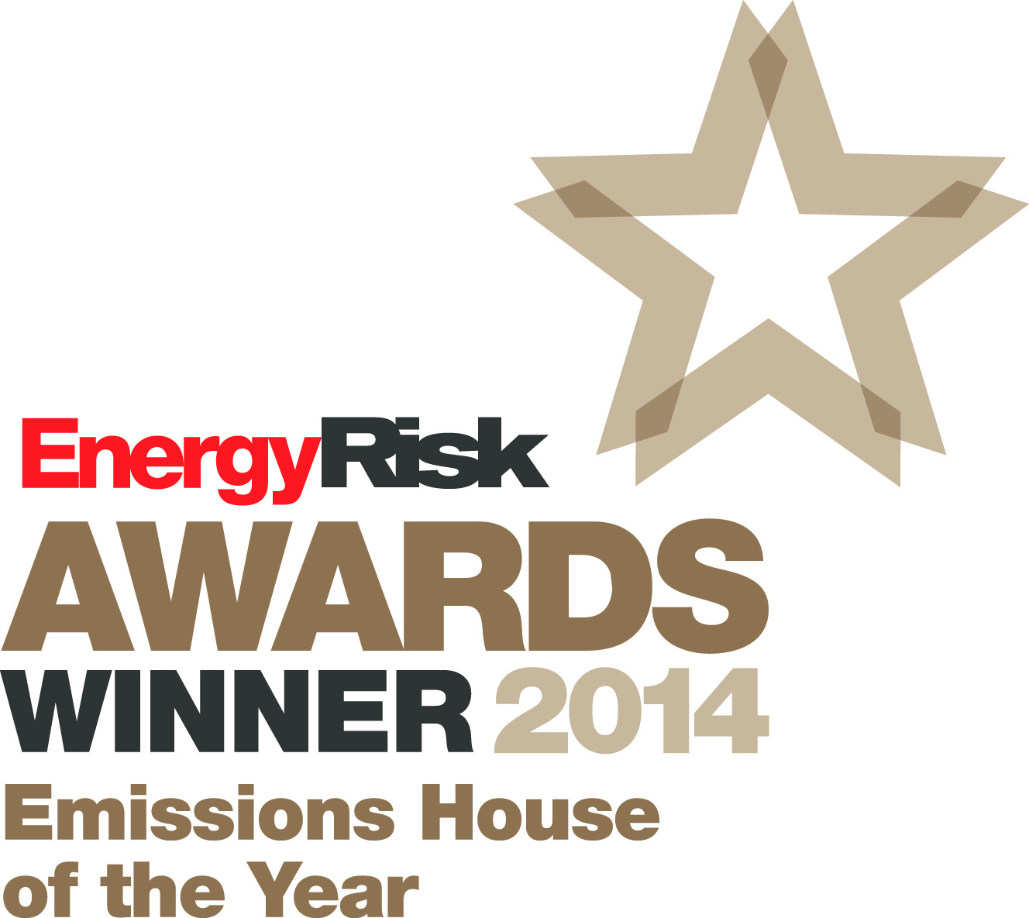
THANK YOU
Tom Moffett
SVP – Environmental Products
Element Markets, LLC
6790 Embarcadero Ln #100
Carlsbad, CA 92011
Office: (858) 752-2004 tmoffett@elementmarkets.com
www.elementmarkets.com
“US Emissions House of the Year”, 2014 and 2010 by Energy Risk
Energy Risk Environmental Rankings
#1 U.S. Regional Greenhouse Gas Dealer
#1 U.S. Voluntary GHG Credit Dealer
#2 Renewable Energy Credit Dealer
#1 NOx & SO₂ Dealer
Environmental Finance Magazine
Best Trading Company in North American Renewable Energy
Runner- Up, Best Trading Company of North American GHG Markets (California)
Best Trading NOx & SO₂ Company Emission Credits
CONFIDENTIAL AND PROPRIETARY

